Slide 1

EMPLOYEE DATASETS ANALYSIS USING EXCEL
STUDENT NAME : P.PAVITHRA
REGISTER NUMBER : 422200500
NM ID:DB4E5A0609EB0E3AFAD439F788E3762D
DEPARTMENT :B.COM(INFORMATION SYSTEM MANAGEMENT
COLLEGE :VALLIAMMAL COLLEGE FOR WOMEN

Slide 2
PROJECT TITLE
EMPLOYEE DATASETS ANALYSIS USING EXCEL

Slide 3
AGENDA
1. PROBLEM STATEMENT
2. PROJECT OVERVIEW
3. WHO ARE THE END USERS
4. OUR SOLUTION AND IT'S PROPOSITION
5. DATASET DESCRIPTION
6.THE "WOW" IN OUR SOLUTION
7. MODELLING
8. RESULT
9. CONCLUSION

Slide 4
PROBLEM STATEMENT
This salary analysis is used to find whether the salary of the is increased or not

Slide 5
PROJECT OVERVIEW
Analyse the salary of the employee by considering various factors like gender, employee ID,start date, employee type, department,etc..,we use these in orders to identify the trends, patterns of different categories of employee salary like high,medium and low.

Slide 6
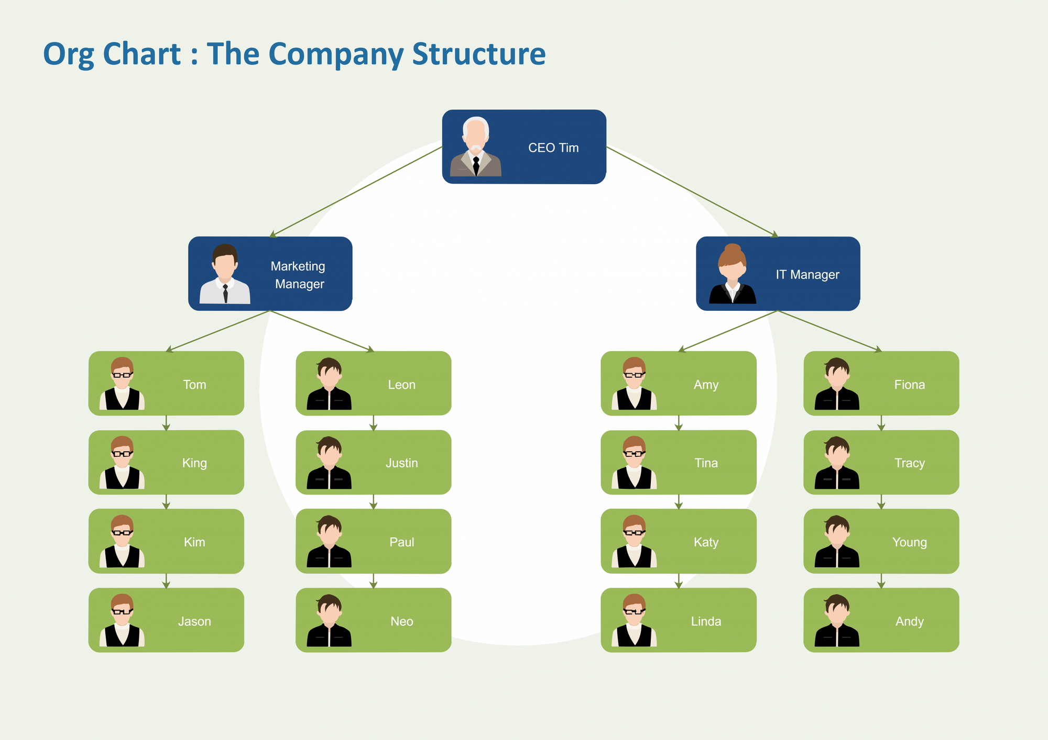
WHO ARE THE END USERS

Slide 7

OUR SOLUTION AND IT'S PROPOSITION
Conditional formatting - Blank values
Sort and filter-filter-remove blank values
Formula-salary
Pivot table-summary
Graph-data visualisation

Slide 8



DATASET DESCRIPTION
1.Employee Dataset-Edunet dashboard
2.11 features
3.5 features Employee ID -Numerical values
4.Name-Text
5.Gender-Text
6.Salary-Numerical values
7.Start date-Numerical values

Slide 9
MODELING
DATA COLLECTION :
*NAAN MUDHALVAN
*EDUNET DASHBOARD
FEATURE SELECTION :
11 FEATURES
5 FEATURES
DATA CLEANING :
COLOUR BLANK VALUES
FILTER-REMOVE BLANK VALUES

Slide 10
SALARYVLEVEL:
HIGH
MEDIUM
LOW
PIVOT TABLE :
EMPLOYEE ID
GENDER
SALARY
SALARY LEVEL
START DATE
EMPLOYEE TYPE
DATA VISUALISATION

Slide 11
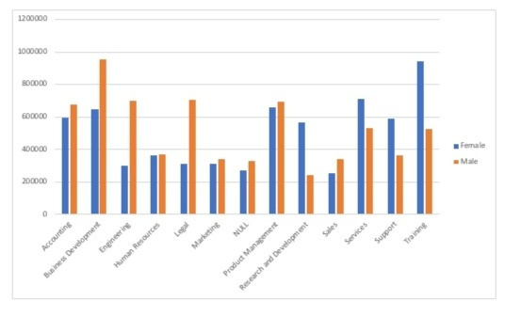
RESULTS

Slide 12
CONCLUSION
While comparing the salary level of the employee,the employees are getting their salary according to their employee type and start date

